Slide 1











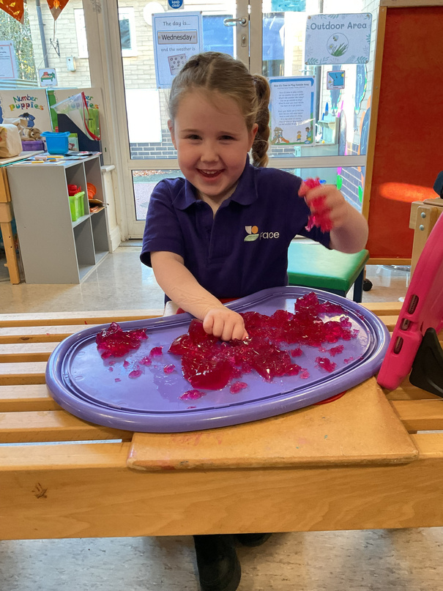
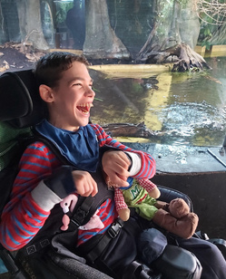








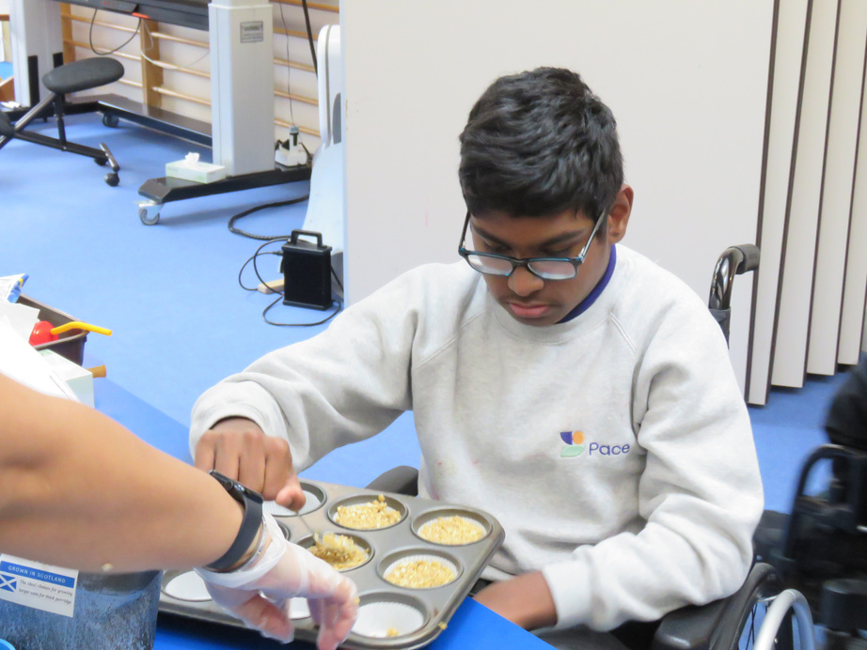
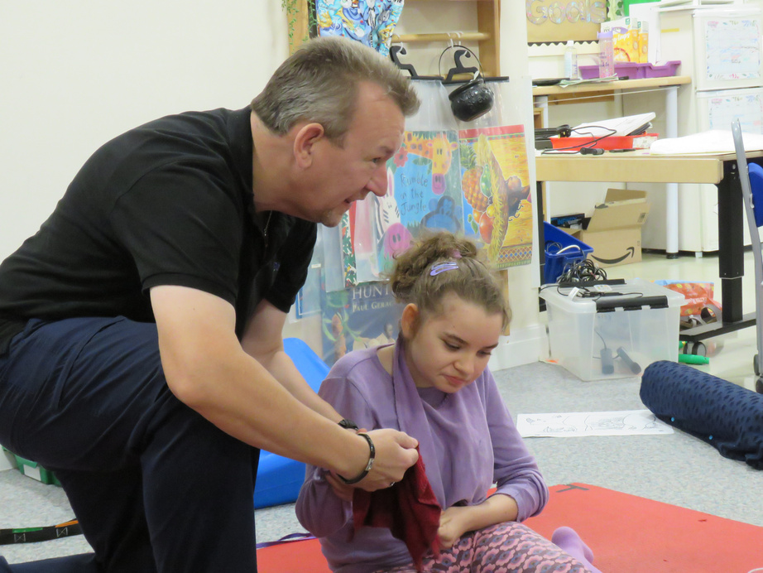




You are invited to
[event] on [date]
where I will be fundraising for
Pace believes that every child with a neurodisability has unique potential and their place to take in the world and a full life to live.
Please come along and help me support Pace with their mission!
RSVP to [contact details]

